Slide 1
Laparoscopic myomectomy
به نام خدا
Saeed Alborzi MD.
Head of gynecology endoscopy unit
Professor and Chair
Department of OB&GYN
Shiraz University of Medical Sciences

Slide 2
Myomectomy indications:
Criteria for myomectomy for infertile patients (American College of Obstetricians and Gynecologists):
Indications: uterine fibroids in patients as a possible factor in infertility or recurrent miscarriage.
Confirmation of indications:
1) large uterine fibroids or specific localization is a possible factor in infertility;
2) there are no other causes of infertility or recurrent miscarriage.
Myomectomy criteria for patients who wish to maintain the uterus (American College of Obstetricians and Gynecologists)
Indications: uterine fibroids in patients who wish to maintain the uterus.
Confirmation of indications:
1) asymptomatic uterine fibroids of such size that it can be palpated transabdominally; patient has problems;
2) uterine fibroids, which is a possible cause of uterine bleeding (profuse bleeding with congestion or duration of more than 8 days; anemia due to acute or chronic blood loss)

Slide 3
Indications for laparoscopic myomectomy
The decision to perform laparoscopic myomectomy must be made based on the size, number, and location of the myomas and the experience of the surgeon. Most surgeons have their own criteria for laparoscopic myomectomy.
As a general rule, a laparoscopic approach can be used if there are fewer than four myomas in different uterine locations, also, a myoma size greater than 10-12 cm is typically best approached by laparotomy.
Characteristics that increase the frequency of complications:
Removal of more than three myomas
Fibroid diameter greater than 5 cm
Multiple intramural or intraligamentous fibroids.
In 1991, Nezhat et al reported on the laparoscopic removal of myomas as large as 15 cm in diameter.
In 2003, Sinha et al reported on 51 laparoscopic myomectomies for large myomas ranging in size from 9-21 cm with a mean myoma weight of 700 g and concluded that the laparoscopic approach was a safe alternative to laparotomy.
In light of the variation in these opinions, surgeon experience is a critical factor in decision to proceed with laparoscopic myomectomy.

Slide 4
Contraindications of laparoscopic myomectomy:
any uterine malignant tumors
giant myomas (any difficulty that may occur in securing the visual Field).
Moreover, in many cases of laparoscopic myomectomy , the intraoperative bleeding volume defines the adaptation limit of surgery. The American College of Obstetricians and Gynecologists in 2008 recommended that in the case of a uterine myoma of 5 to 8cm in size with multiple uterine nodules and deep interstitial myoma, it is necessary to perform laparotomy or laparoscopic-assisted surgery only in accordance with the operator’s skill.

Slide 5
Pregnancy outcome after laparoscopic myomectomy:
Laparoscopic myomectomy is in fact a minimally invasive procedure with a shorter recovery and a lower overall risk of complications than abdominal myomectomy, and some data suggest that a laparoscopic approach results in less severe adhesive disease, particularly fewer adnexal adhesions, which may impact fertility.
Overall pregnancy rates and spontaneous abortion rates with laparoscopic myomectomy are comparable to abdominal myomectomy

Slide 6
Uterine Rupture After Laparoscopic Myomectomy
One of the major concerns about laparoscopic myomectomy in a woman of reproductive age is the risk of uterine rupture during pregnancy or labor due to insufficient closure or healing of a laparoscopic myomectomy incision. There are several case reports of uterine rupture after laparoscopic myomectomy. The incidence is difficult to determine, as most of these reports do not describe the incidence per number of procedures performed. In addition, the method of closure is not cited in all reports. However, when laparoscopic myomectomy is performed by experienced surgeons, uterine rupture or dehiscence is a very infrequent complication after laparoscopic myomectomy .

Slide 7
How to do laparoscopic myomectomy:

Slide 8
Cavity entry & Port placement:

Slide 9
Steps:
Ways to reduce blood loss in myomectomy
preoperative use of drugs;
occlusion of blood flow in vessels;
chemical hemostasis;
Surgical techniques
Myoma enucleation
laparoscopic suturing in multiple layers
Serosal closure
Fibroid removal
Adhesion barriers

Slide 10
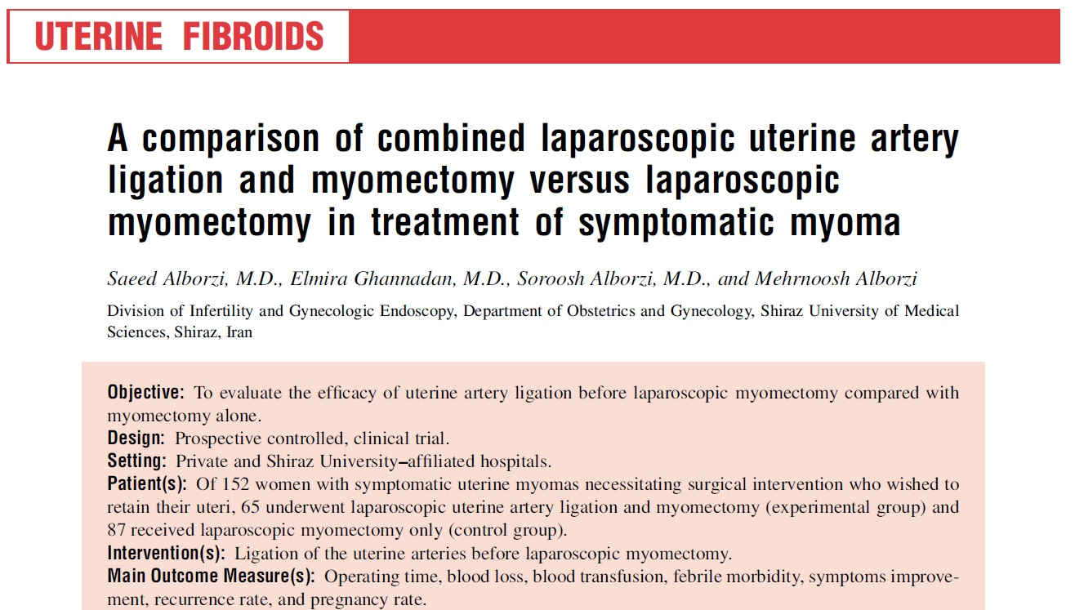

Slide 12
Thanks for your attention!

