Slide 1
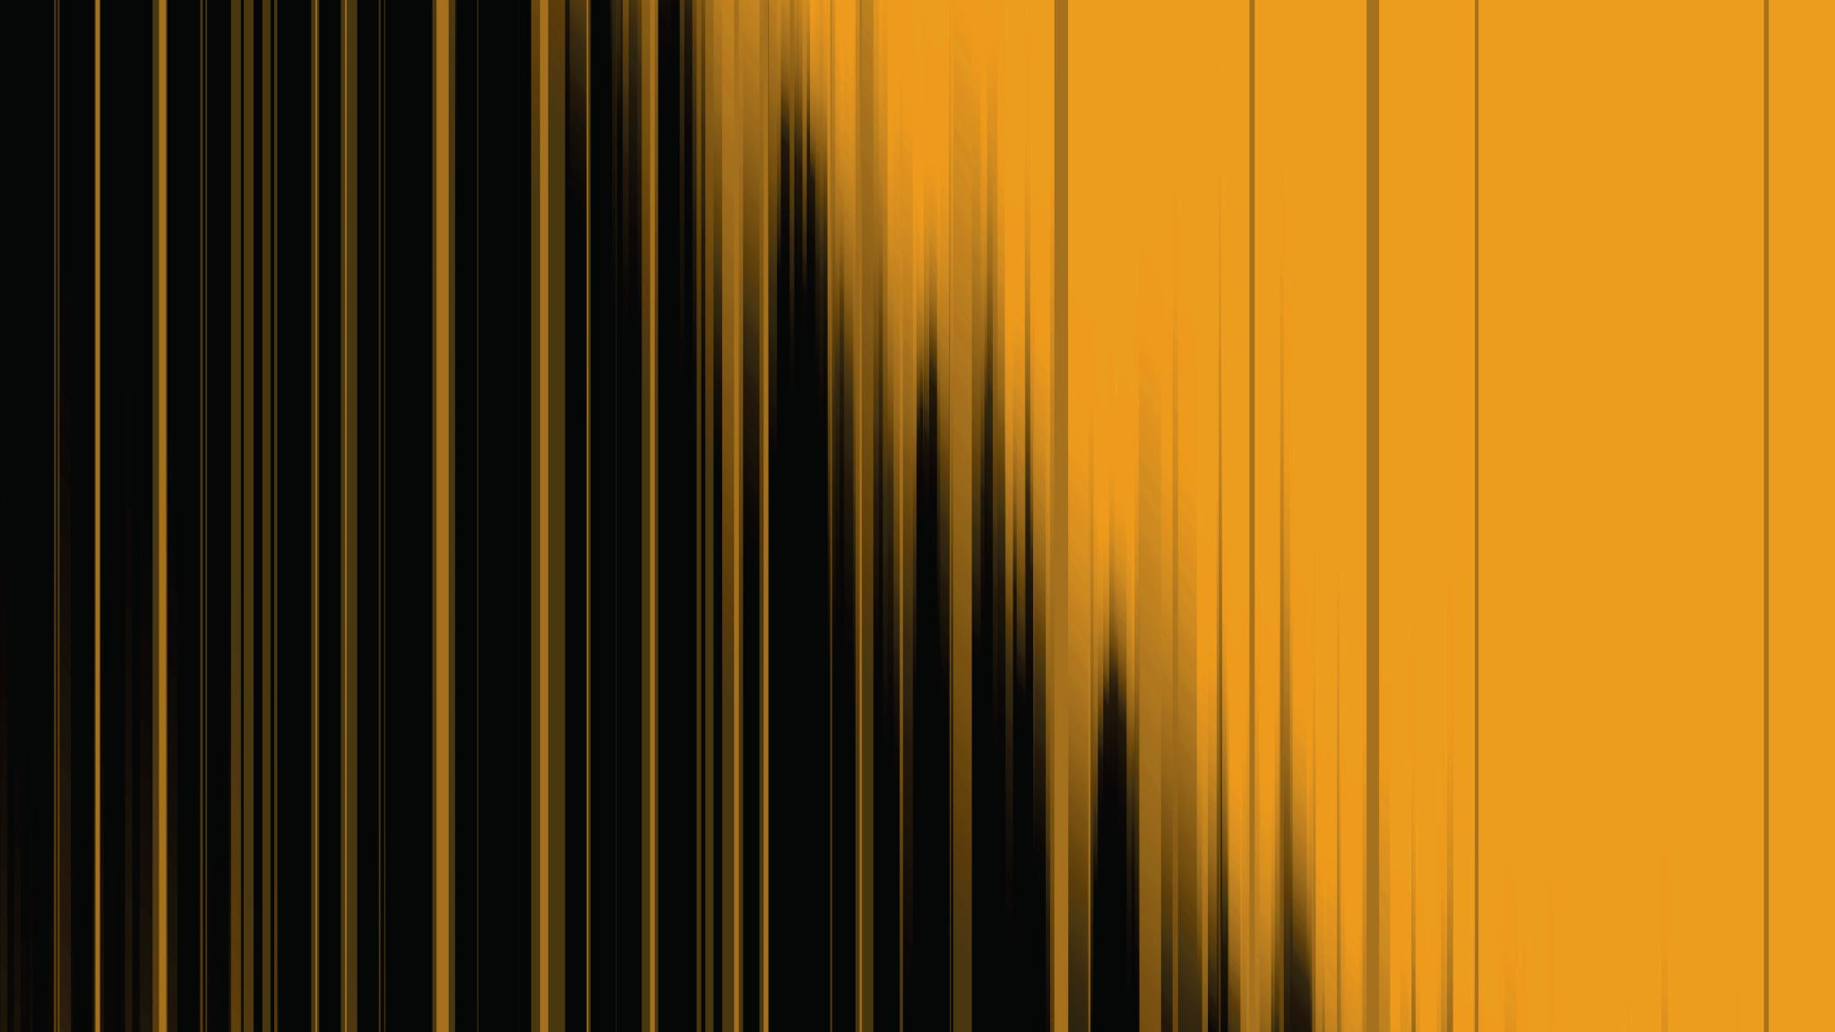
In the name of god
Polycystic Ovarian Syndrome

Slide 2
Classic syndrome originally described by Stein and Levanthal (1935):
• Hyperandrogenism
• Menstrual irregularity
• Polycystic ovaries
• Central adiposity
Few of these original features are now considered consistent findings in PCOS

Slide 3
NATIONAL INSTITUTES OF HEALTH AND CHILD HEALTH AND HUMAN DEVELOPMENT(1990)
• Chronic anovulation
• Hyperandrogenemia or Clinical signs of hyperandrogenism
• Exclusion of other androgenic disorders

Slide 4
ROTTERDAM CRITERIA (2003)
(2 out of 3)
Oligo- or anovulation
Clinical and/or biochemical signs of hyperandrogenism
Polycystic ovaries (>12 peripheral follicles or increased ovarian volume >10ml)

Slide 5
AE-PCOS SOCIETY 2006
Hyperandrogenism: hirsutism and/ or hyperandrogenemia
Ovarian dysfunction: oligo-anovulation
Exclusion of other androgen excess or related disorders
Polycystic ovaries

Slide 6
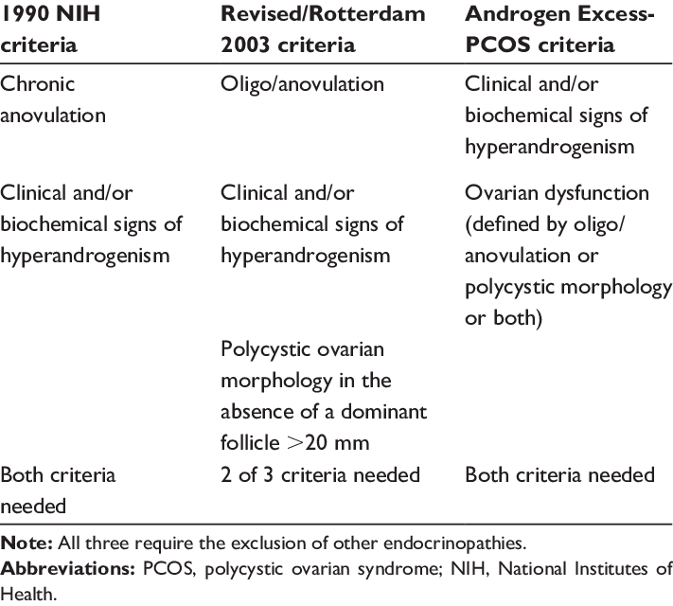

Slide 7
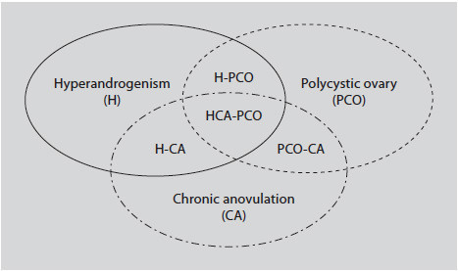
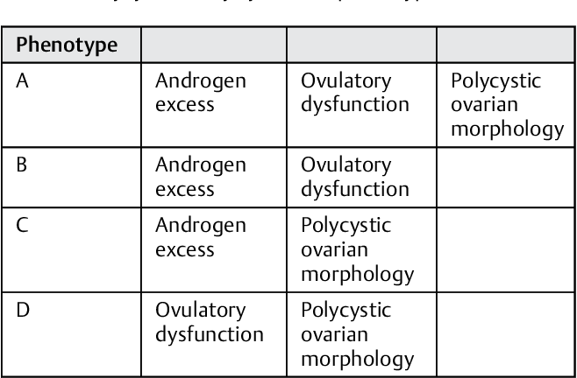

Slide 9
Chronic anovulation
Normal cyclic menses result from normal ovulatory function. The normal inter-menstrual interval ranges between 21 and 35 days
The majority of women with pcos, approximately 60-85%, exhibit gross menstrual dysfunction
The most common abnormalities are oligomenorrhea and amenorrhea

Slide 10
Biochemical evidence of hyperandrogenism
Key feature of PCOS, resulting primarily from excess androgen production in the ovaries and, to a lesser extent, in the adrenals as well as in excess body fat

Slide 11
In women with PCOS, approximately 60% of circulating androstenedione derives directly from the ovaries and the remainder from the adrenals
Similarly, 60% of circulating testosterone is secreted directly by the ovaries, with most of the remainder deriving from peripheral conversion of androstenedione

Slide 12
Biochemical evidence of hyperandrogenism
The most often reported parameters are the level of free testosterone (FT) or free androgen(FA) or the free androgen index (FAI).
FAI = 100 X ((Total Testosterone (nmol/L)/SHBG (nmol/L))

Slide 14
Clinical hyperandrogenism
70-80% of PCOS women exhibit clinical manifestations of hyperandrogenism.
Acne: an inflammatory disease of the sebaceous glands, characterized by comedones and pimples, especially on the face, back, and chest, and, in severe cases, by cysts and nodules resulting in scarring
Alpecia
Hirsutism: defined as excessive growth of terminal hair in androgen-dependent areas of the body in women

Slide 16
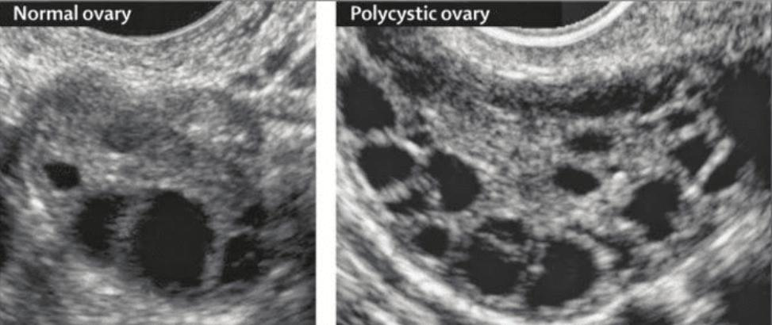
Ultrasound and polycystic ovarian morphology (pcom)
Ultrasound should not be used for the diagnosis of PCOS in those with a gynecological age of <8 years (<8years after menarche), due to the high incidence of multi-follicular ovaries in this life stage.

Slide 17
New regulations 2018
Using endovaginal ultrasound transducers with a frequency bandwith that includes 8MHz, the threshold for PCOM should be on either ovary, a follicle number per ovary of > 20 and / or an ovarian volume > 10ml, ensuring no corpora lutea, cysts or dominant follicles are present.
2003: Polycystic ovaries on ultrasound (8 or more subcapsular follicular cysts <10 mm in diameter and increased ovarian stroma)
12 or more follicles measuring 2-9 mm and/or increased ovarian volume(>10 ml)

Slide 18
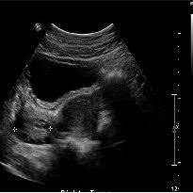
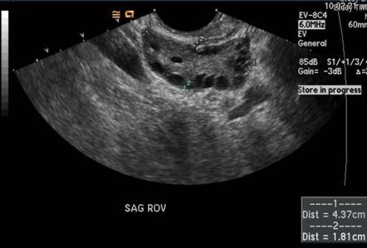
I
Transvaginal ultrasound approach is preferred in the diagnosis of PCOS.
In Transabdominal ultrasound reporting is best focused on ovarian volume with a threshold of >10 ml , given the difficulty of reliably assessing follicle number with this approach.

Slide 19
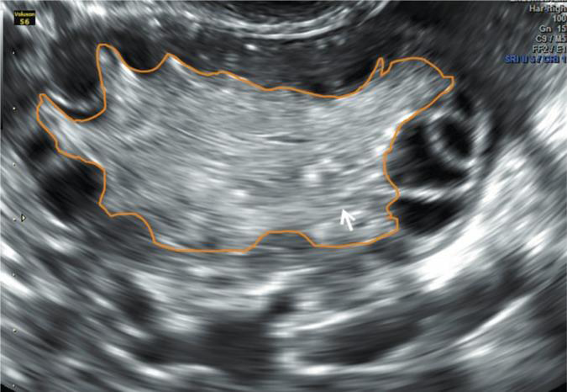
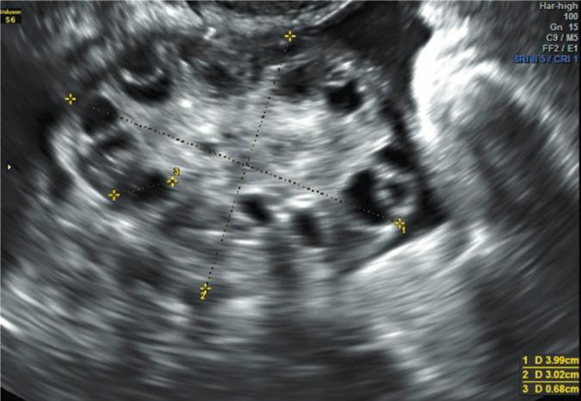
Over-diagnosis
Increase PCOM diagnoses since the Rotterdam criteria were published even in normal women.

Slide 20
In patients wth irregular menstural cycles and hyperandrogenism, an ovarian ultrasound is not necessary for PCOS diagnosis;
However, ultrasound will identify the complete PCOS phenotype.

Slide 22
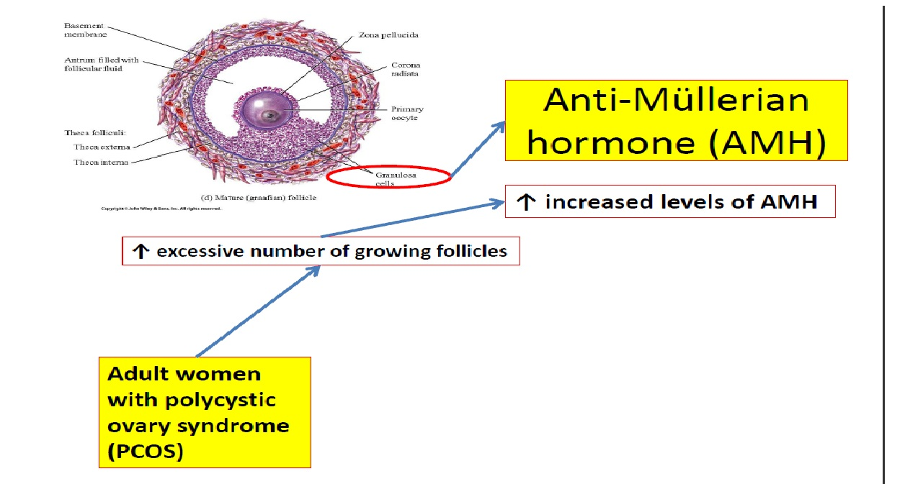

Slide 23
A threshold of AMH ≥ 5 ng/mL may be used as a further suggestion of PCOS, much like the utility of a reversed FSH/LH ratio in serving to suggest ovulatory dysfunction

