Slide 1
Ovarian Hyperstimulation Syndrome
COORDINATOR;
M.E.Parsanezhad M.D
PANELISTS.
S.Amooee M.D.
A.zarei M.D
Z.Shomali M.D.
S.Davoodi M.D..
N.Namazee M.D
SUMS CME, SHIRAZ JAN 2023

Slide 2
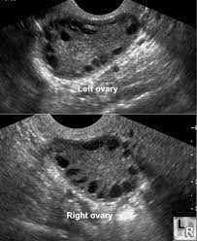
Case Presentation 1
32 y/o lady , nulligravid, known case of irregular menses, with CC of primary infertility for 8 years.
No abnormal finding in physical examination, she is a white, tall, low BMI, with mild hirsutism.
Other parts of history is not significant. FSH:4.1, LH: 9.4, TSH: 2.1, Prolactin: 21,
AMH: 6.2, S/A: NL. No conception after 3 cycles of IUI…
ART was planned….
What stimulation protocols do you suggest?

Slide 3
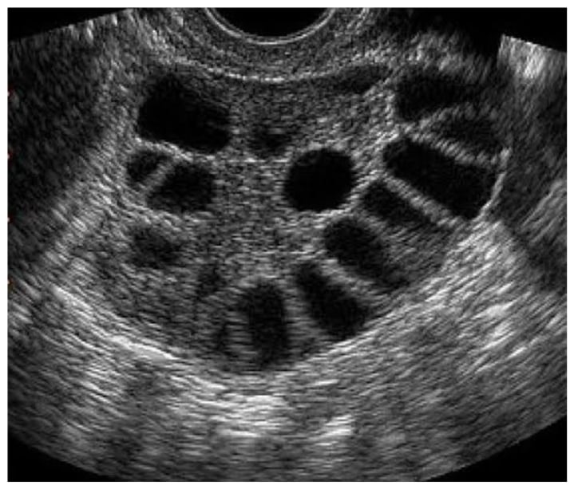
Follicle monitoring, on the 12th day of the cycle, sonography reveals:
Rt ovary: contains 15 follicles( 2x 18mm, 4x 17mm, others 15-16mm)
Lt ovary: contains 13 follicles( 4x18mm, 3x17mm, others 12-16 mm)
What is your order to con….the ART process?

Slide 4
After 5 days of ovum pick up, the patient runs in to ER with complaint of abdominal pain and dyspnea…
Physical Exam including abdominal and pelvic exam;
Tense protruded abdomen, full posterior and lateral CUL-DE-SAC…
BP: 100/60 , PR:107, RR:30, O2 sat: 90%
Which of the followings do you suggest?
A: Sonography
B: LFT , RFT, CBC
C: Abdominal CT
D: Keep her NPO

Slide 5
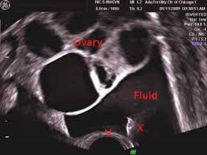
Abdominal Sonography
Large bilateral ovarian enlargement,
each M 20 x 15 cm.., containing multiple
Large follicles M 30 mm.
Severe free fluid in peritoneal cavity…
Which of the followings do you suggest?
A: …………..
B: LFT , RFT, CBC
C: Abdominal CT
D: Keep her NPO

Slide 6
Which of the followings do you suggest?
A: …………..
B: LFT , RFT, CBC
C: Abdominal CT
D: Keep her NPO

Slide 7
Case Presentation 2
26 y/o lady, G1, CC: Abdominal pain from 2 days ago…
Hx & physical exam: Primary infertility 5 years, IUI about 3 weeks ago
Stimulation Protocol: Cinal F(???!!!) and Letrozole. Tense abdomen, dyspnea …
Sonography( 2 days ago): Single gestational sac that was seen with MSD
about 5.3 compatible with GA:5 wk. No sign of fetal pole or yolk sac.
Enlarged both ovaries with multiple cystic lesions.
Severe free fluid in pelvic cavity.

Slide 8
Which of the following choice do you suggest as the next step?
A: HCT & Hb%
B: CA 125
C: B.HCG level
D: Chest sonography

Slide 9
Chest sono: Moderate pleural bilateral effusion….
Abdominal Sono: Single gestational sac that was seen with MSD, about 5.3 compatible with GA:5 wk. No sign of fetal pole or yolk sac. Enlarged both ovaries with multiple cystic lesions. Severe free fluid in pelvic cavity.
Lab data: WBC: 8900, Hb: 14.3, Hct: 44.1, Ast: 40, Alt: 63, Alb: 2.9, Cr: 1.1
Five days later…..
Wbc: 8100, Hb: 11.2, Hct: 35, Alb: 3.6, Cr: 0.9, Ast:23, Alt: 32
Pt has no abdominal pain or dyspnea.

Slide 10
Case Presentation 3
35 y/o, G1L1( NVD), presented with abdominal swelling and pain and severe free fluid
Med & Surgical Hx: Laparascopic ovarian cystectomy 2 months ago, 1 week ago, she took letrozole for secondary infertility.
Lab data: wbc: 6400, Hb: 12.1, plt:136000, Bun:11, Cr:1.6.

Slide 11
MANAGEMENT
With suspicious to malignancy, tumor marker was checked.CA125 high Ascites analysis: LDH: 157, Sugar: 88, Pro: 287, Alb/pro: 1.2.
Pathology of the ovarian cystectomy was followed that showed cancer.

Slide 12
THANK YOU

Slide 14
Case History:
A 26-year-old woman presented with a 7-year history of infertility. Workup
identified male factor abnormality, and the woman was offered intracytoplasmic sperm
injection (ICSI) treatment. She underwent standard controlled ovarian stimulation, and
five oocytes were retrieved, of which two fertilized and both embryos were transferred.
Two weeks later she had a positive pregnancy test. Two weeks following the pregnancy
test a transvaginal ultrasound scan showed a regular intrauterine sac with a yolk sac.
One week later she presented with marked abdominal pain and distension. A transvaginal
ultrasound scan showed significant ascites, markedly enlarged multicystic ovaries
(10×6×7 cm each ovary) and a fetal pole with fetal heart.
Laboratory tests results included: hemoglobin 11.2 gm/dL; hematocrit 31.5%; liver enzymes,
renal function and coagulation profile normal, and CA 125 270 U/mL.

