Slide 1



Current Recommendations and Guidelines for Diagnosis & Management of PCOS
By: Dr. Sirous Rostami
Shiraz Fertility Center

Slide 2
Polycystic Ovarian Syndrome
The most common endocrinopathy affecting women
Prevalence estimated between 8 and 13%
  depending on definition used and the population studied
No one agreed upon definition
All definitions require that secondary causes be excluded
  ie: Late onset CAH, hyperprolactinemia, androgen secreting tumors

Slide 3
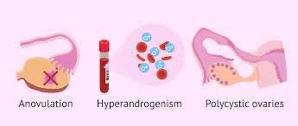
Rotterdam Criteria
Most commonly used definition
Oligomenorrhea or amenorrhea
Hyperandrogenism – Clinical or biochemical
Polycystic appearing ovaries by ultrasound diagnosis
Requires 2 out of 3 to make a diagnosis

Slide 4
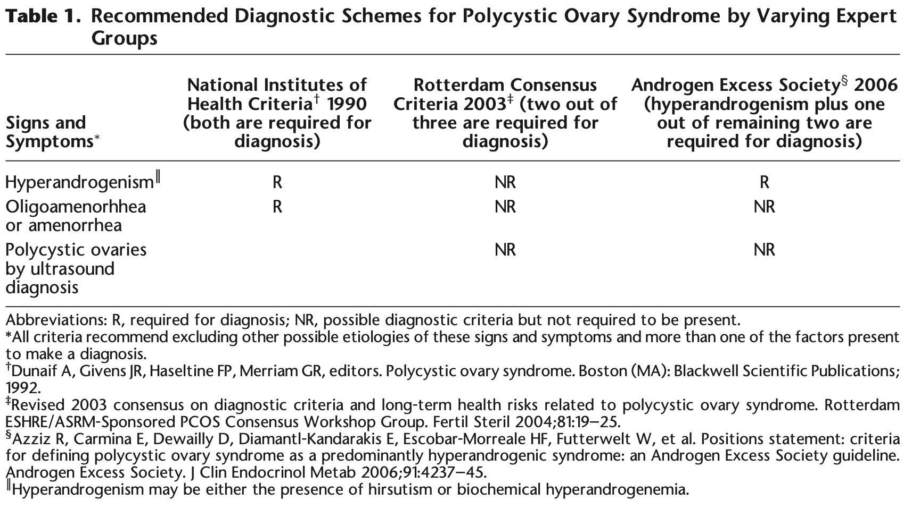

Slide 5
Menstrual Dysfunction Definitions
From 3 years post menarche to perimenopause:
< 21 or > 35 days or < 8 cycles per year
From 1 year post menarche:
> 90 days for any one cycle
By age 15 or > 3 years post thelarche (breast development)
Primary amenorrhea

Slide 6
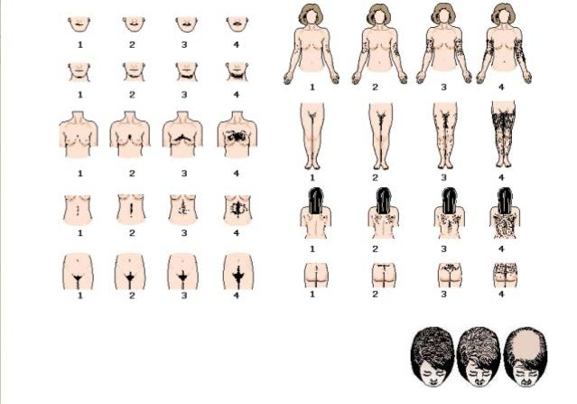
Hyperandrogenism: Clinical Dx
Hirsutism
  Modified Ferriman Gallwey score (mFG)
    ≥ 4-6 = hirsuitism
  Depends on ethnicity
  Must ask about self-treatment
Acne
Androgenic alopecia
Acanthosis nigricans

Slide 7
Hyperandrogenism: Biochemical Dx
Total Testosterone (liquid chromatography-mass spectrometry)
  Reference range: lab specific
  Markedly elevated levels (>150ng/dL): consider other diagnoses
Calculate Free Testosterone, Free Androgen index or calculated bioavailable T – likely most accurate assessment
  Requires Total T, SHBG and albumin for calculations
Direct Free Testosterone
  Poor sensitivity and accuracy in commercial labs

Slide 8
US criteria for PCO
Updated based on newer US technology (TVUS 8MHz bandwidth)
≥ 20 follicles (2-9mm) on either ovary and/or
Increased volume (≥ 10 ml) on either ovary
  Must not include a corpus luteum, cyst(s), or dominant follicles (<10mm)
Cannot use in women on OCPs

Slide 9
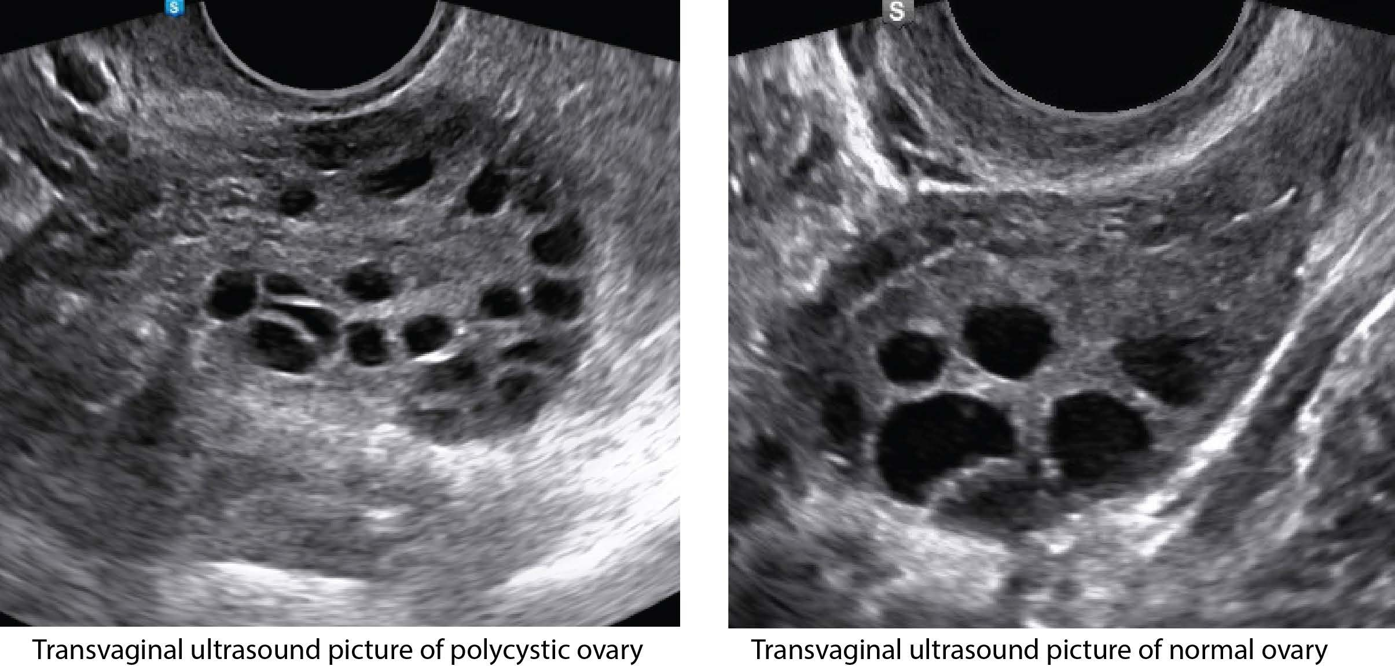
Elevated AMH although not part of the diagnostic criteria is usually elevated and directly related to the AFC on ultrasound

Slide 10
Diagnosis in Adolescents
Requires both oligo-anovulation and hyperandrogenism
Ultrasound not recommended for diagnosis (<8 years after menarche) due to a high AFC
Be careful not to over diagnose: Abnormal menstrual cycles are normal in the first year post menarche as part of the pubertal transition

Slide 11
Diagnosis in Adolescents
Abnormal uterine bleeding requiring evaluation
  1 to <3 years post menarche: < 21 or > 45 days
  1 year post menarche > 90 days for any one cycle
  Primary amenorrhea by age 15 or > 3 years post thelarche (breast development)
“high risk”- some features of PCOS - but does not meet criteria
  Reassess closer to sexual maturity (~8 years post menarche)
  If on OCPS - stop for at least 3 months for reassessment

Slide 12
Differential Diagnosis
Non-classical Congenital Adrenal Hyperplasia
Presentation: Anovulation and Hirsutism
Cause: Genetic Defect of 21 hydroxylase (CYP21)
Highest Prevalence: Ashkenazi Jews, Hispanics, Yugoslavs, Alaskan native Americans and Italians
  High risk women with suspected PCOS should be screened
Screening: Check AM fasting 17-hydroxyprogesterone (normal < 2-4 ng/mL)
  High levels →Perform ACTH stimulation test

Slide 13
Differential Diagnosis
Rule out Thyroid Disease, Hyperprolactinemia, Hypothalamic amenorrhea, POI
  Typically do not cause hyperandrogenism
Androgen Secreting Tumors
  Rare, consider in pts with severe or abrupt signs of hyperandrogenism
Acromegaly & Cushing’s Syndrome
  Consider evaluation only if other clinical features of these conditions present

Slide 14

Pathophysiology

Slide 15
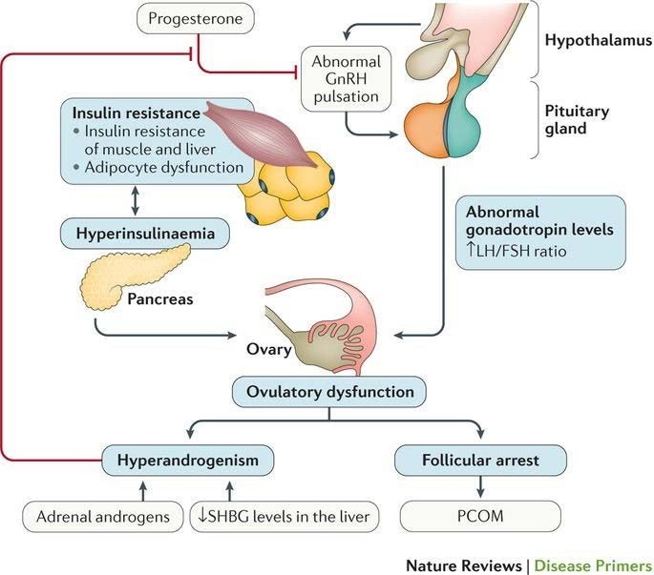
Anovulation: Low Progesterone negative feedback
GnRH pulse generator: progesterone resistant

Slide 16
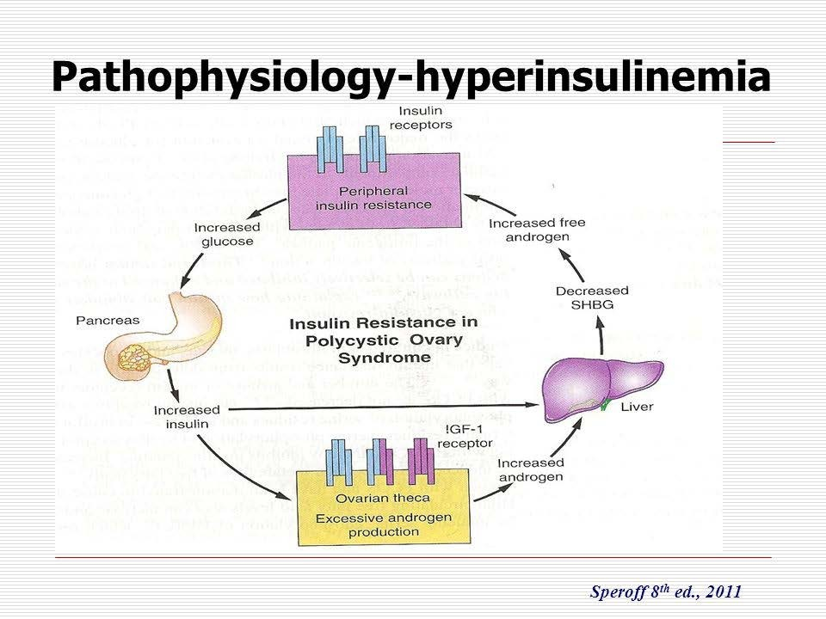

Slide 17
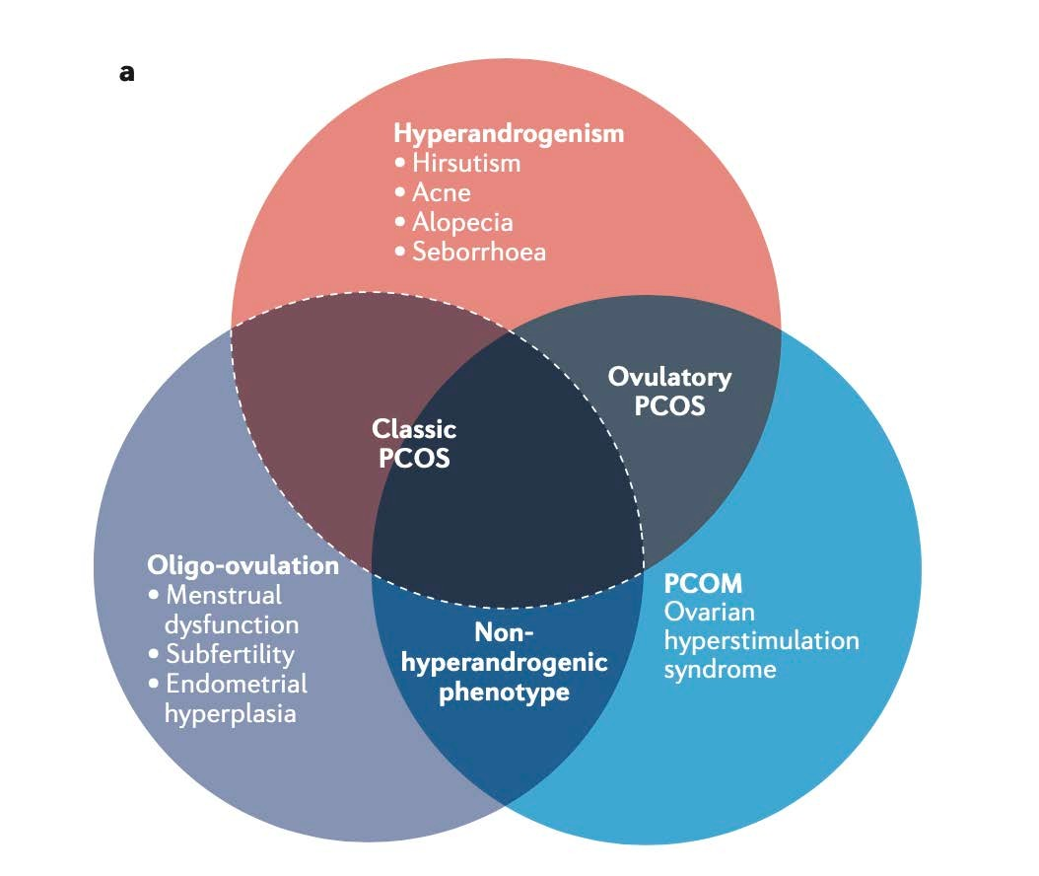
PCOS Phenotypes
Classic PCOS - greatest association with insulin resistance and metabolic comorbidities
Non-hyperandrogenic phenotype has the weakest association with insulin resistance and metabolic comorbidities
Escobar-Morreale, H. F. (2018). Polycystic ovary syndrome: definition, aetiology, diagnosis and treatment. Nature Reviews Endocrinology, 14(5), 270

Slide 18
Associated Co-morbidities
Obesity
Insulin Resistance
Metabolic Syndrome
Hyperlipidemia
Cardiovascular disease
Sleep Apnea
Endometrial Cancer
Depression & Anxiety
Infertility

Slide 19
PCOS and Metabolic Syndrome
Metabolic syndrome present in ~ 1/3 of women with PCOS
A Vicious cycle: Insulin resistance of PCOS is associated with an increase abdominal fat deposition which in turn increases insulin resistance
Both Hyperinsulinemia and obesity are associated with elevated risk of dyslipidemia, hypertension and type II DM
In Insulin resistant states → fatty acids are mobilized from the muscle and fat cells to the liver → increases TG production
  Major contributor to cardiovascular risk

Slide 20
Work up after diagnosis is made
Blood pressure
BMI
Fasting lipid profile (overweight & obese women)
2 hour Glucose tolerance test
  If normal repeat screening at least once every 2 years
  Screen annually pts with impaired glucose tolerance
Question about si/sx of sleep apnea → sleep study
Screen for depression and anxiety

Slide 21
TREATMENT

Slide 22
Treatment Goals
Reduce hyperandrogenic characteristics
Manage metabolic dysfunction and decrease risk factors (obesity) for cardiovascular disease and diabetes
Contraception for women not trying to conceive
Prevent Endometrial hyperplasia and cancer
Ovulation induction for those trying to conceive
Must account for patient preferences; treatment may result change in features they consider important

Slide 23
Treatment for Women and Adolescents Not Pursuing Pregnancy

Slide 24
Lifestyle Modifications (obese women)
“Weight loss of as little as 5 to 10% can reduce cardiometabolic risk
factors and androgen levels, improve menstrual function and possibly fertility”¹
Nutrition:
  Calorie restriction, no one diet has been shown to be superior
  Consider referral to a dietician
Exercise
  A minimum of 150 min/week of moderate intensity exercise or
  A minimum 75 min/week of vigorous exercise or combination
  Should include muscle strength activity on at least 2 days
¹Moran LJ, Pasquali R, Teede HJ, Hoeger KM, Norman RJ. Treatment of obesity in polycystic ovary syndrome: a position statement of the Androgen Excess and Polycystic Ovary Syndrome Society. Fertil Steril 2009;92:1966-82.

Slide 25
Lifestyle Modifications (obese women)
Behavioral Strategies:
  Goal setting, goal-setting, self-monitoring, frequent check ins for accountability, cognitive therapy
Weight loss drugs:
  Can be used for short term weight loss, many have been taken off the market due to safety concerns
Bariatric Surgery
  A 2017 meta analysis in women with PCOS and severe obesity
demonstrated a significant decrease in androgens, decrease in hirsutism and return of ovulatory cycles

Slide 26
Combined Hormonal Contraception
First line therapy
  in combination with lifestyle modifications in overweight or obese women
Mechanism of Action:
  Suppresses pituitary LH secretion
  Suppresses Ovarian Androgen production
  Increases SHBG
Corrects irregular menstrual cycles
Provides reliable contraception
Provides endometrial protection
Reduces Hirsutism, acne and other hyperandrogenic features

Slide 27
Combined Hormonal Contraception
No one formulation is superior
  Consider lowest effective dose
  Consider avoiding most-androgenic progestin (ie; levonorgestrel)
    Norgestimate – low androgenetic, no relative increased risk of VTE
Screen for contraindications – follow the medical eligibility criteria for contraceptive use
If contraindicated or pt declines COCs
  Medroxyprogesterone 5-10mg 10-14 days/ month, progestin IUD, or ”mini-pill”
  Will not improve acne or hirsutism
  Cyclic progestin will not provide contraception

Slide 28
Metformin
The Diabetes Prevention Program has shown that metformin can delay the development of diabetes in high-risk populations
Metformin should be used in women with PCOS and documented insulin resistance or diabetes
Metformin should be consider in high risk women – morbid obesity, metabolic syndrome without confirmed insulin resistance
  Reduce risk of diabetes
  Decrease hyperinsulinemia → reduction of androgens

Slide 29
Metformin
Metformin should be used in combination with lifestyle modifications and contraception if patient not seeking pregnancy
  Can restore ovulatory cycles
Metformin may be associated with weight loss
Common side effects: diarrhea, nausea, vomiting, abdominal bloating, flatulence, and anorexia
  Side effects can be reduced by starting at a small dose and increasing gradually as tolerated by the patient
  Goal therapy: 1,500–2,000 mg/day divided or ER dosing

Slide 30
Statins
Potential role in treatment of PCOS however confounding evidence exists
  Improves lipid profiles (agreed upon)
  Reduction in serum androgens
  Improvement of hyperandrogenic features
  Increase in ovulatory cycles
Large RCTs are needed

Slide 31
Treatment of Hirsutism

Slide 32
Treatment of Hirsutism
First Line: Combined Oral Contraceptive (increase SHBG, Decrease ovarian androgen production)
2nd Line: Combined Oral Contraceptive + Spironolactone if no or insufficient improvement after 6 months of therapy or Spironolactone alone if contraindication to COCs (must used alterative contractive method)
3rd line: Addition of another anti-androgen:
Mechanical Hair removal usually required in addition to medication

Slide 33
Anti-Androgens
Quality of evidence for treatment of hirsutism is low
A recent meta-analysis - including only 12 trials – reported minimal efficacy with use of any anti-androgen
All Anti-androgens require concurrent use of a reliable contraceptive due to the low risk of feminization of a male fetus genitalia
  COCs may have a additive benefit

Slide 34
Anti- Androgens
Spironolactone: Androgen receptor antagonist, aldosterone antagonist
  Typical dosing 50-100 mg, twice a day
  Side effects: hypotension, hyperkalemia
  May take up to 6 months to see a clinical benefit
Finasteride: inhibits 5-α-reductase
  Dose: 5 mg/day
  Better tolerated than other anti-androgens
Flutamide: androgen receptor agonist
  Dose 150-250mg/day
  Rare concern for hepatitis

Slide 35
Topical Treatment
Eflornithine
  Inhibitor of the enzyme ornithine decarboxylase,
  Approved by the FDA for treatment of female facial hirsutism
  Applied topically twice a day to facial areas
  Approximately 60% of women show significant improvement after 6 months
The addition of eflornithine to laser treatment is superior in the treatment of hirsutism than laser alone

Slide 36
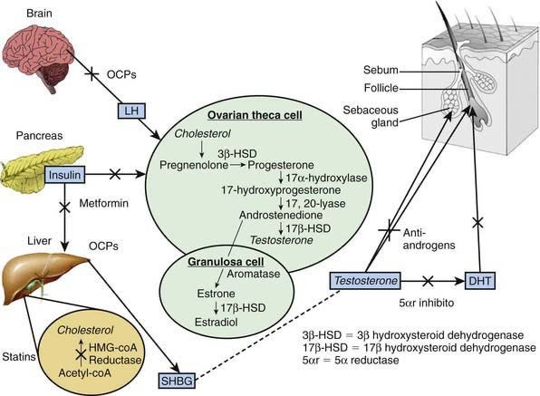
(Adapted from Hassan A, Gordon CM: Polycystic ovary syndrome in adolescence, Curr Opin Pediatr 19[4]:389–397, 2007.)

Slide 37
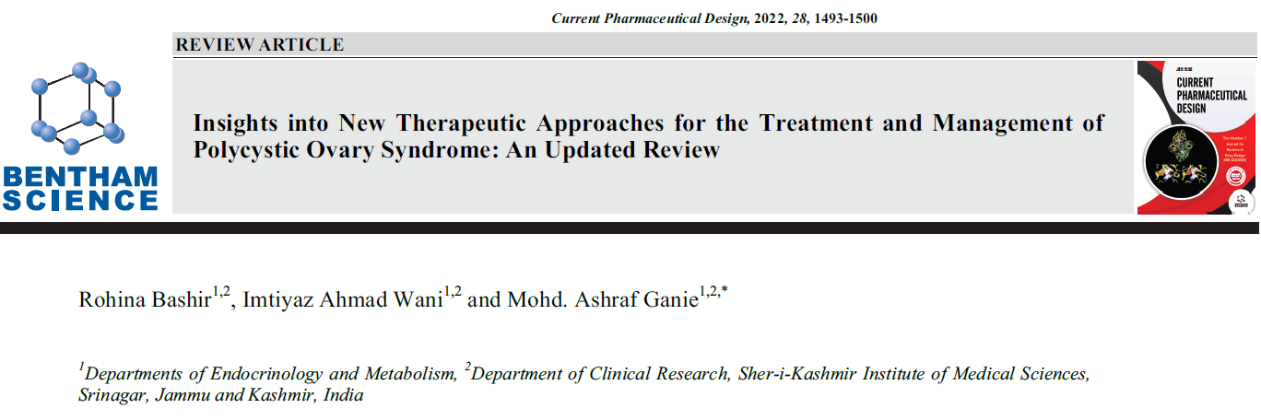

Slide 39


