Slide 1
OHSS
By:
Niloofar Namazi
Assistant Professor of Obstetrics and Gynecology Department, SUMS

Slide 2
Ovarian hyperstimulation syndrome (OHSS) is the most serious complication of controlled ovarian hyperstimulation (COH) for assisted reproduction technologies
It occurs when the ovaries are hyperstimulated and enlarged due to fertility treatments (or rarely, mutations in the follicle-stimulating hormone [FSH] receptor)
shift of serum from the intravascular space to the third space, mainly to the abdominal cavity.

Slide 3
In its severe form, OHSS is a life-threatening condition because it can cause venous or arterial thromboembolic events, including stroke and loss of perfusion of an extremity.

Slide 4
EPIDEMIOLOGY
The frequency of OHSS depends upon the clinical setting (eg, ovulation induction/ovarian stimulation followed by timed intercourse or intrauterine insemination versus in vitro fertilization [IVF]) and the classification criteria used for OHSS
Although the most severe form of OHSS is rare, it represents an iatrogenic complication with a potentially fatal outcome in young women undergoing fertility treatment
When ovulation is induced with clomiphene citrate or aromatase inhibitors, either for timed intercourse or intrauterine insemination, ovarian enlargement consistent with mild OHSS may occur, but moderate to severe OHSS is rarely seen

Slide 5
In the setting of IVF, the overall incidence of moderate and severe OHSS in some series was 3 to 6 percent and 0.1 to 2 percent, respectively
In an early cohort of IVF cases, an increased incidence of severe OHSS cases was observed over time: from 0.06 percent in 1987 to 0.24 percent in 1996
An increase of severe OHSS requiring hospitalization from 0.9 to 1.8 percent over one year was observed in a second series, following a worldwide increase in the number of IVF cycles

Slide 6
The use of dopamine agonists may also have contributed to a decrease in the incidence of OHSS in the last decade

Slide 7
PATHOGENESIS
In the spontaneous ovulatory cycle, hypothalamic-pituitary-ovarian feedback mechanisms limit follicle recruitment to a small number of early antral follicles, followed by selection of a single dominant follicle that ovulates in response to the midcycle luteinizing hormone (LH) surge
OHSS occurs when the equilibrium established by feedback mechanisms seen in the normal menstrual cycle is disrupted by the administration of exogenous gonadotropins followed by human chorionic gonadotropin (hCG).

Slide 8
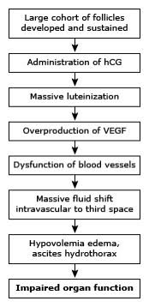
OHSS can be viewed as an exaggeration of a physiologic process

Slide 10
Recruitment of a large number of small antral follicles into a functional cohort
Sustained development of numerous large antral follicles until ovulation (or luteinization)
Excessive production of vascular endothelial growth factor (VEGF) by the developing corpora lutea, after hCG administration
Exaggerated perifollicular neovascularization with some of the new blood vessels exhibiting increased permeability
Escape of follicular fluid and perifollicular blood containing large amounts of VEGF into the peritoneal cavity
Functional impairment of blood vessels (not only within the ovary)
Massive fluid shift from the intravascular to the third compartment, also known as "third spacing," resulting in intravascular hypovolemia concomitant with the development of
edema, ascites, hydrothorax, diminished renal blood flow, and/or pericardial effusion
Impairment of cardiac, renal, pulmonary, and liver function

Slide 11
OHSS typically occurs in the setting of:
Ovarian stimulation with gonadotropins with an exuberant ovarian response, evidenced by multiple follicular development, high serum estradiol concentrations, and ovarian enlargement by the end of stimulation
Use of exogenous hCG to trigger the final steps of oocyte maturation
Production and release of vasoactive substances by granulosa/luteal cells
Binding of the vasoactive substances to their receptors and activation of downstream signalling, leading to increased vascular permeability
Pregnancy following ovarian stimulation, where rising hCG secretion from the placenta can stimulate increased VEGF secretion from the ovary

Slide 12
Ovulatory hCG injection
Exogenous human chorionic gonadotropin (hCG) administration plays a key role in the pathogenesis of OHSS
Regardless of the degree of ovarian response to gonadotropin stimulation, OHSS does not occur unless an ovulatory dose of hCG is administered
Exogenous hCG induces massive luteinization of granulosa cells, which leads to the production of vasoactive substances such as VEGF that increase vascular permeability
Such massive luteinization is usually not observed when the final steps of oocyte maturation are achieved with drugs other than hCG

Slide 13
The effect of hCG is related to its high biological activity, which is six to seven times that of endogenous LH (because of hCG's longer half-life)

Slide 14
VEGF/vascular permeability
A number of substances have been proposed as the cause of increased vascular permeability post-hCG administration, but vascular endothelial growth factor (VEGF) appears to play the main role
VEGF is a member of the family of heparin-binding proteins that act directly on endothelial cells to induce proliferation and angiogenesis. VEGF mRNA and protein are expressed by granulosa and theca cells late in follicular development and after ovulation. Studies on ascitic fluid from patients with severe OHSS have demonstrated that VEGF is the major capillary permeability agent

Slide 15
VEGF serum concentrations are positively correlated with the risk of developing OHSS and with the severity of its form
Increased capillary permeability and fluid shift to the third space are usually confined to the ovaries and abdomen
patients who get pregnant after oocyte donation do not have OHSS, despite high free VEGF levels

Slide 16
Rare causes
Rarely, OHSS may be seen in the absence of exogenous gonadotropin administration
OHSS may be the consequence of the high production of endogenous gonadotropins (hCG) or gonadotropin-like molecules (thyroid-stimulating hormone [TSH]), or enhanced sensitivity to endogenous gonadotropins (mutations in the folliclestimulating hormone [FSH] receptor)

Slide 17
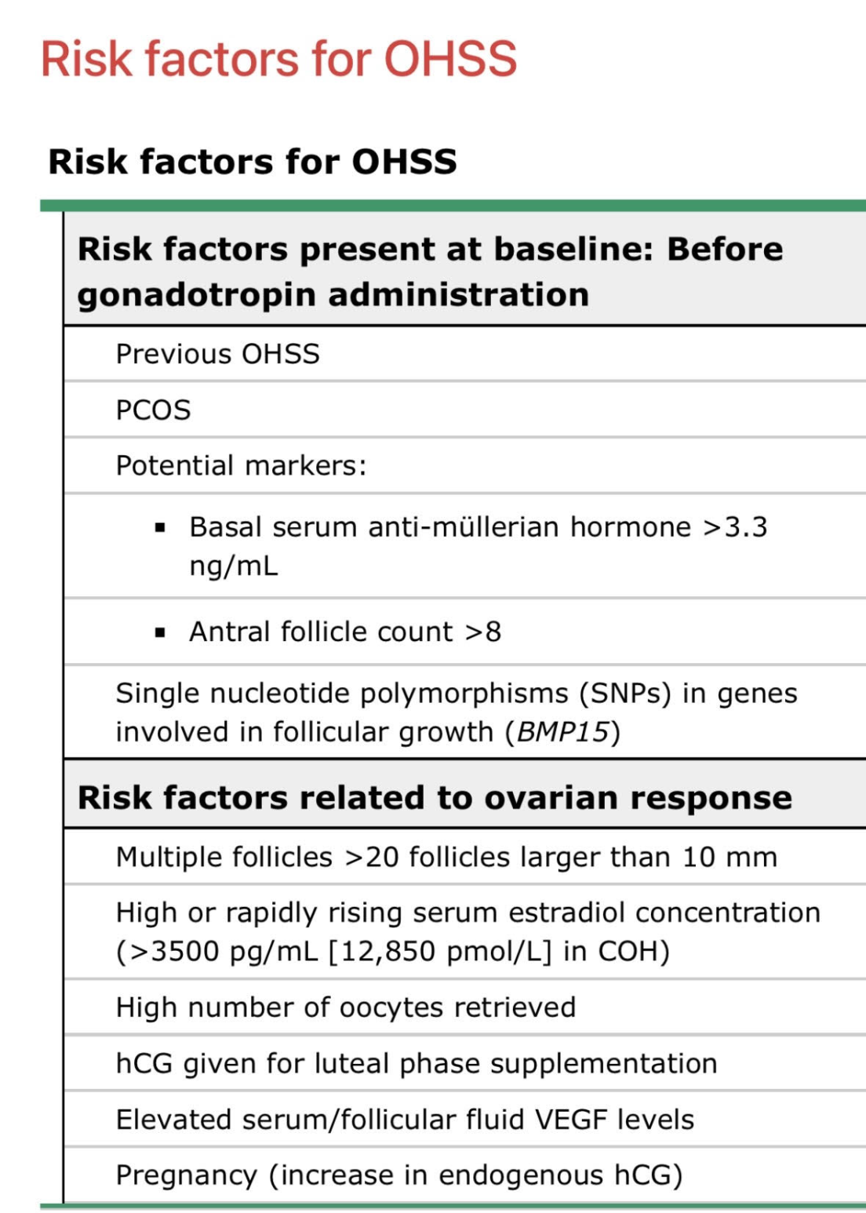
RISK FACTORS

Slide 18

Thank you for your attention

