Slide 1
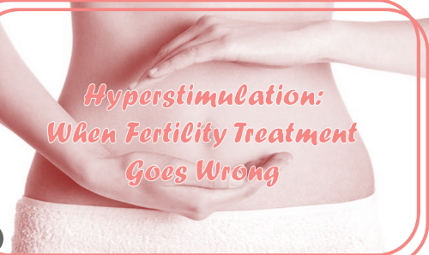
Dr.Sara Davoodi
Fellowship of infertility

Slide 3
Symptoms:
Abdominal bloating
Abdominal discomfort/pain, need for
analgesia
Nausea and vomiting
Breathlessness, inability to lie flat or talk in full sentences
Reduced urine output
Leg swelling
Vulval swelling
Associated comorbidities such as thrombosis

Slide 4
The main event in the pathogenesis of OHSS is ovarian enlargement, secretion of vasoactive substances, ascites, and hypovolemia resulting from an acute extravasation of fluid into the interstitial space.

Slide 5
OHSS is classified into 4 categories based on the severity of symptoms, signs, and laboratory findings.

Slide 6
Mild ovarian hyperstimulation syndrome: It is defined by the enlargement of bilateral ovaries with multiple follicular and corpus luteal cysts, measuring up to 5-8 cm and accompanied by abdominal bloating and mild abdominal pain.

Slide 8
Moderate ovarian hyperstimulation syndrome:
It is characterized by the enlargement of the ovaries up to 12 cm, accompanied by abdominal bloating due to an increase in ovarian size and gastrointestinal symptoms (e.g., nausea, vomiting, and diarrhea) as well as ultrasound evidence of ascites.
A rapid weight gain of over 3 kg might
be the initial sign of moderate
hyperstimulation.

Slide 10
Severe ovarian hyperstimulation syndrome:
About 2% of OHSS cases are classified as severe.
The severe form is described by the presence of
large ovarian cysts (>12×12 cm),
clinical ascites with or without hydrothorax,
hyperkalemia (potassium >5 mmol/L),
hyponatremia (sodium <135 mmol/L),
hypo-osmolarity (osmolarity <282 mOsm/kg),
hypoproteinemia (serum albumin <35 g/L),

Slide 11
oliguria (<300 mL/d or <30 mL/h),
creatinine 1.1–1.5 mg/dL,
and hypovolemic shock.
Hemoconcentration with hematocrit >45%
white cell count >15000,
liver dysfunction,
increased blood viscosity,
and thromboembolic events occurs in the most severe cases.

Slide 14
Critical ovarian hyperstimulation syndrome
It is diagnosed when there is severe ascites or hydrothorax,
hematocrit >55%,
white cell count >25000/mL,
oliguria or anuria,
creatinine ≥1.6 mg/dL,
creatinine clearance <50 mL/min,
thromboembolism,
acute respiratory distress syndrome.

Slide 21
The End

